Slide 1


Slide 2
Project Title: Multiple Games in One Web App
Course no: CSE 2100
Course Title:
Software Development Project - I

Slide 3
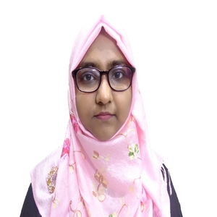
Submitted to
Tasmia Jannat
Lecturer
Department of CSE,
RUET

Slide 4
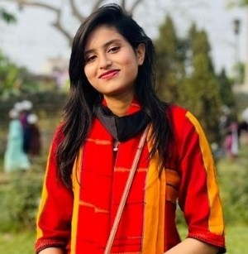
Submitted by
Raiyan Zannat
Roll – 1903073
Section – B
Department of CSE,
RUET

Slide 5


Presentation Outline
PO
Introduction
Objectives
Software Features
Language & Tools
Future Work
Summary

Slide 6
Introduction
For a busy and focused generation like ours, it is necessary to just take a break for a while and let the brains loosen up. During that break-hour, playing non-brainstorming games really helps to relax. Again, we experienced COVID pandemic hours from 2020 to the end of 2021. During those idle hours, most teenage boys and girls and others did not have any idea how to spend their time. A situation like this can come in years ahead too. Besides this, This project is a way to unproductive time. In this project, I am going to incorporate two mini and easy to play games. Anyone with an internet connection can play these games. The rules of these games are also simple so that anyone can understand how to play and win.

Slide 7
Objectives
Way to escape boredom
Spend leisure hour
Simple way of entertainment
Preventing youngsters from being indulged in any other illegal activities by engaging them in playing non-harmful games
Way to kill time for old and retired persons
O

Slide 8
Software features
Game-1 : Guess The Number / GTN

Slide 9
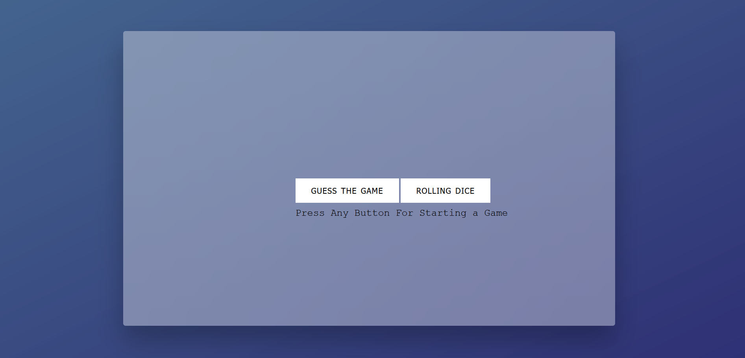
The Home Page of Combined Static Website

Slide 10
Main View of GTN
To log in as a user

Slide 11
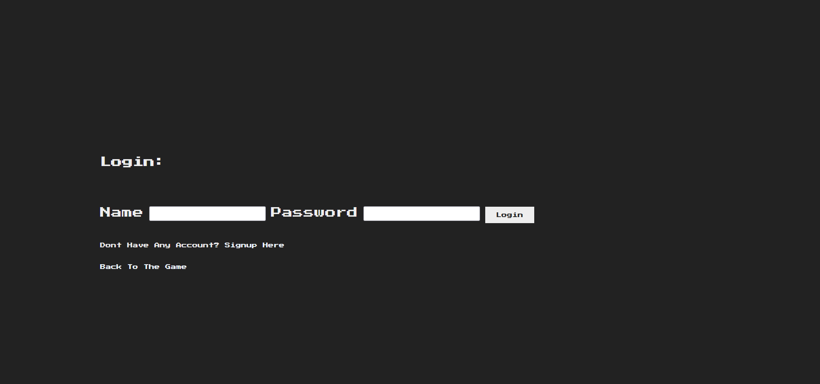
Login Page of GTN
username
password
Sign Up for
New Users

Slide 12
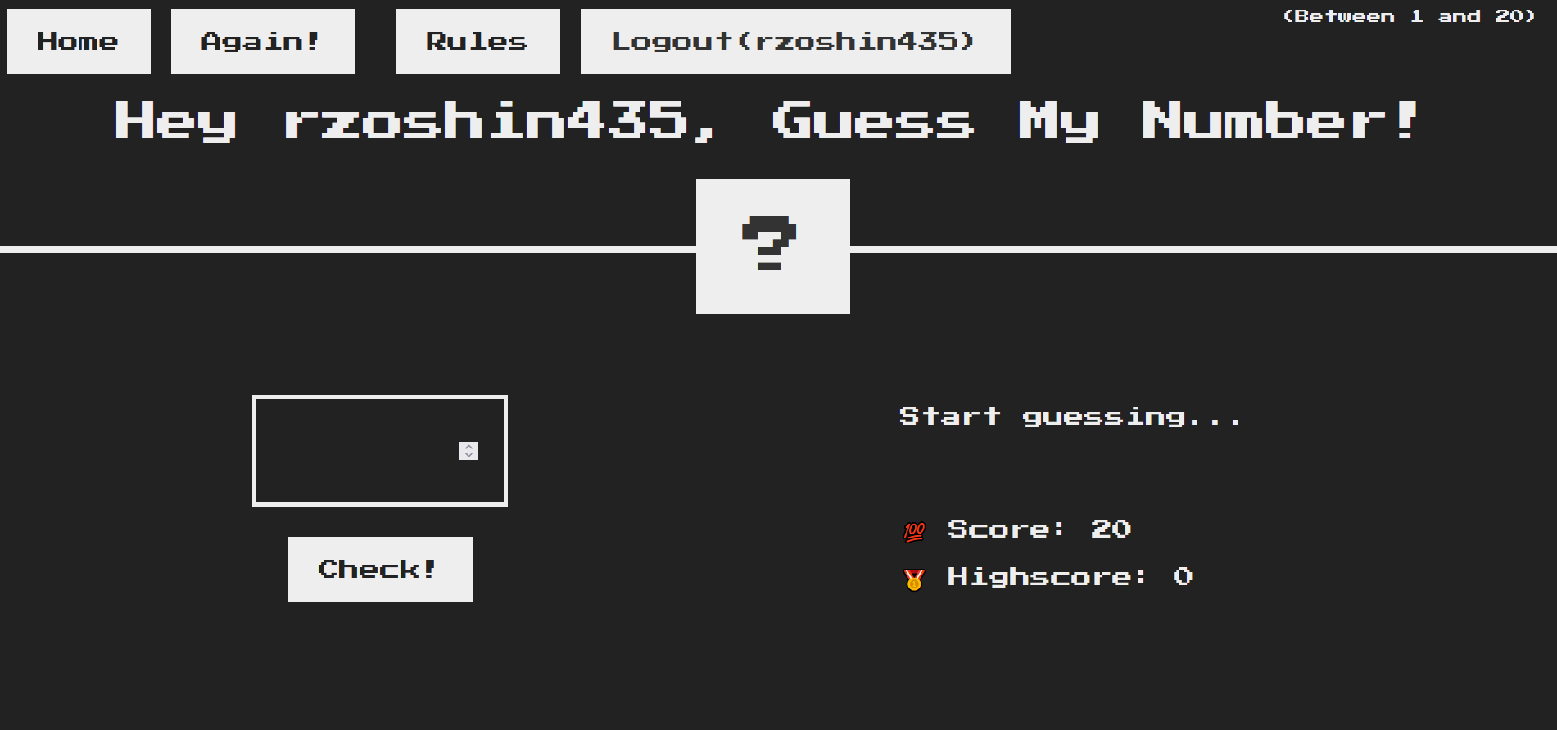
Rules of game
To log out
Back to Home Page
To start new game
Guess
Box

Slide 13
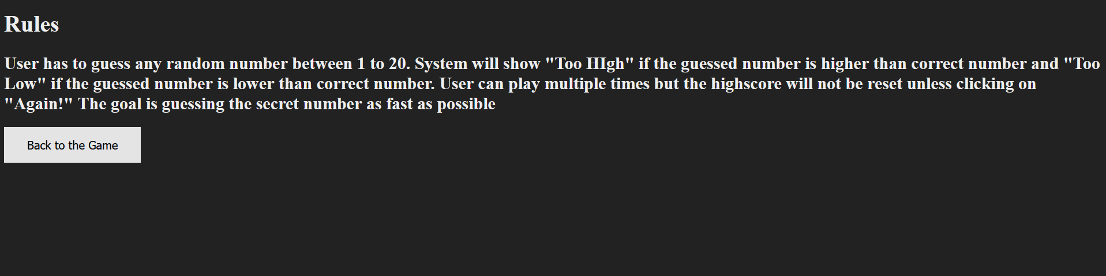
RULE OF GTN

Slide 14
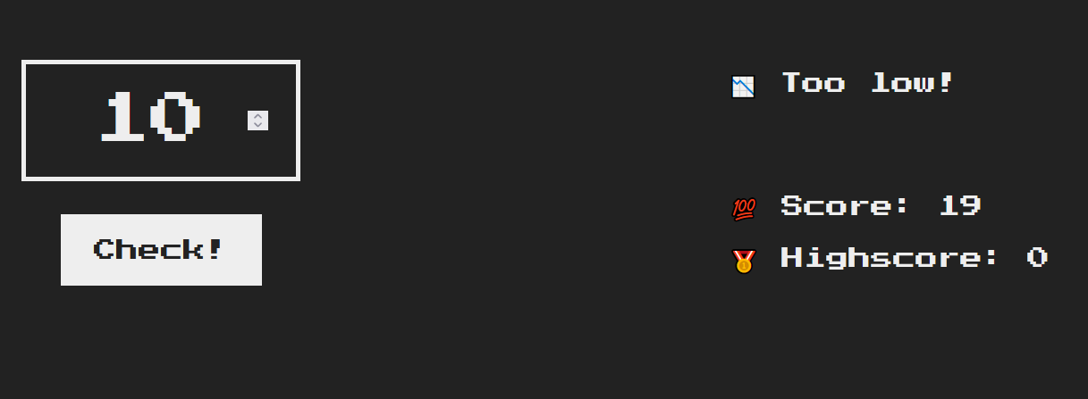
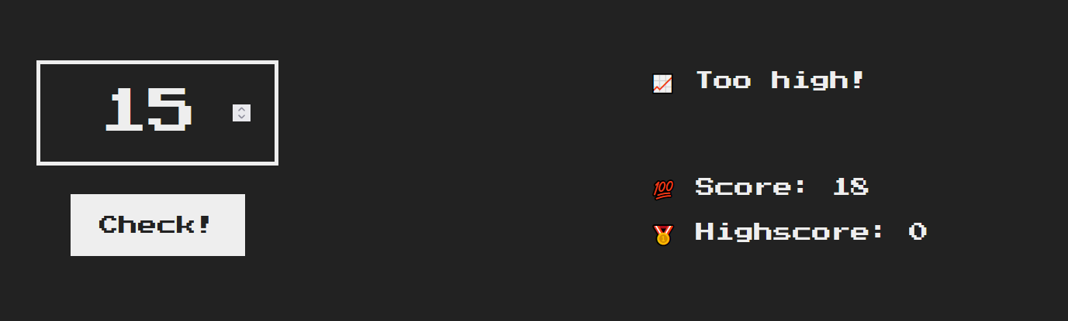
Score Board
Score is decreasing as the player keeps on guessing
Message showing “Too low” as the guessed number is less than
Correct number
Message showing “Too High”
as the guessed number is more
than correct number

Slide 15
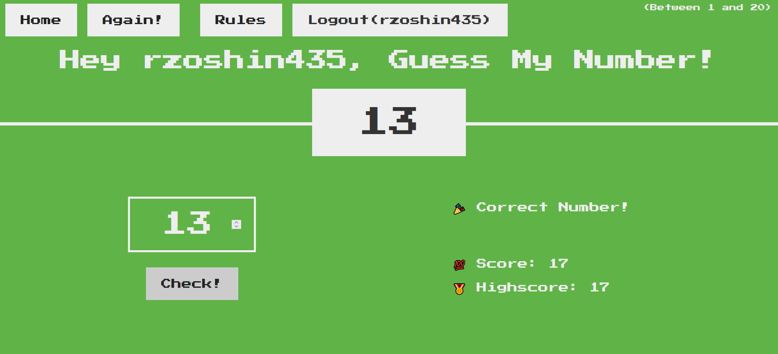
Winner-mode view of GTN

Slide 16
Software Features
Game-2 : Roll The Dice

Slide 17
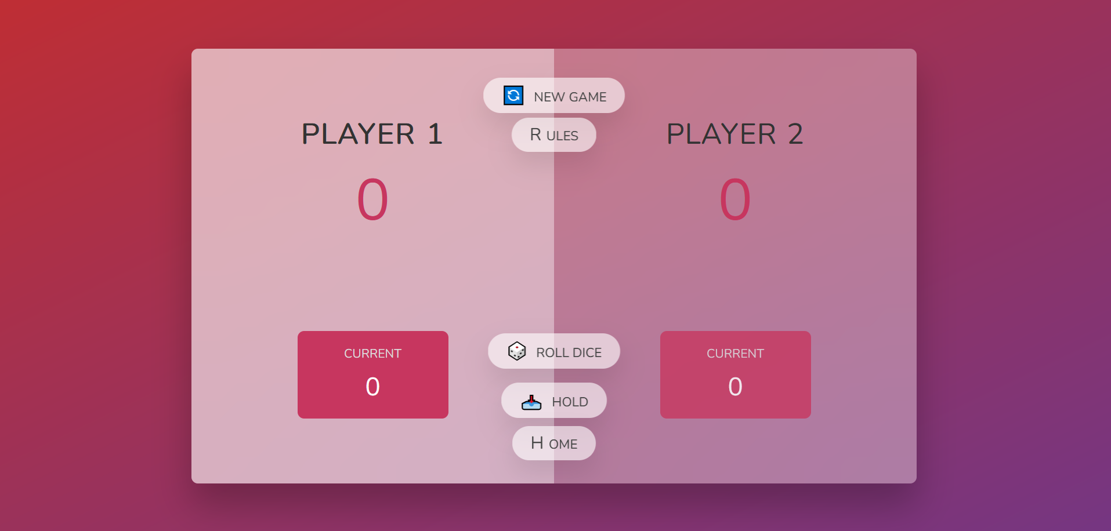
To start a new game
Score held by Player 2
Score Held By Player 1
To know the rules
To Roll Dice
To Hold the
score
To go back to
Home Page

Slide 18
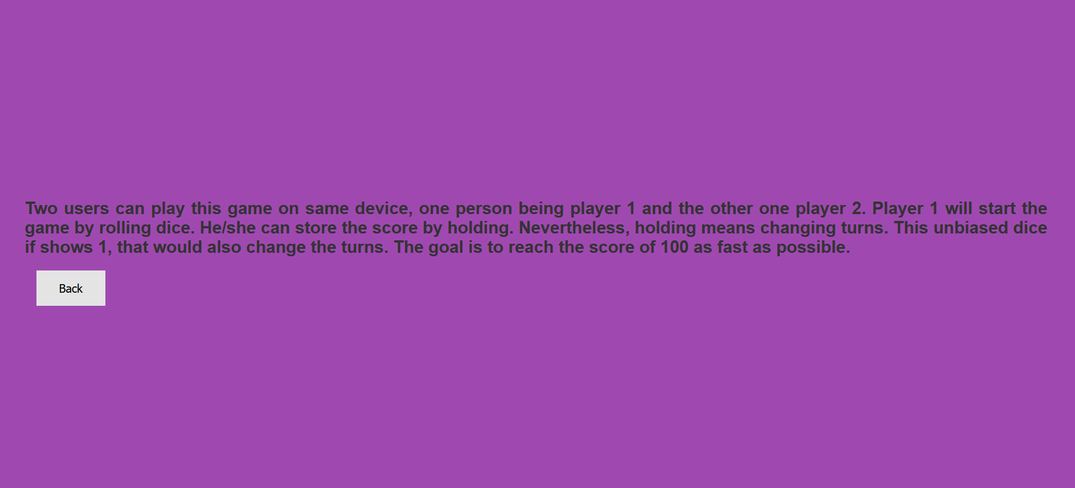
RULE OF RTD

Slide 19
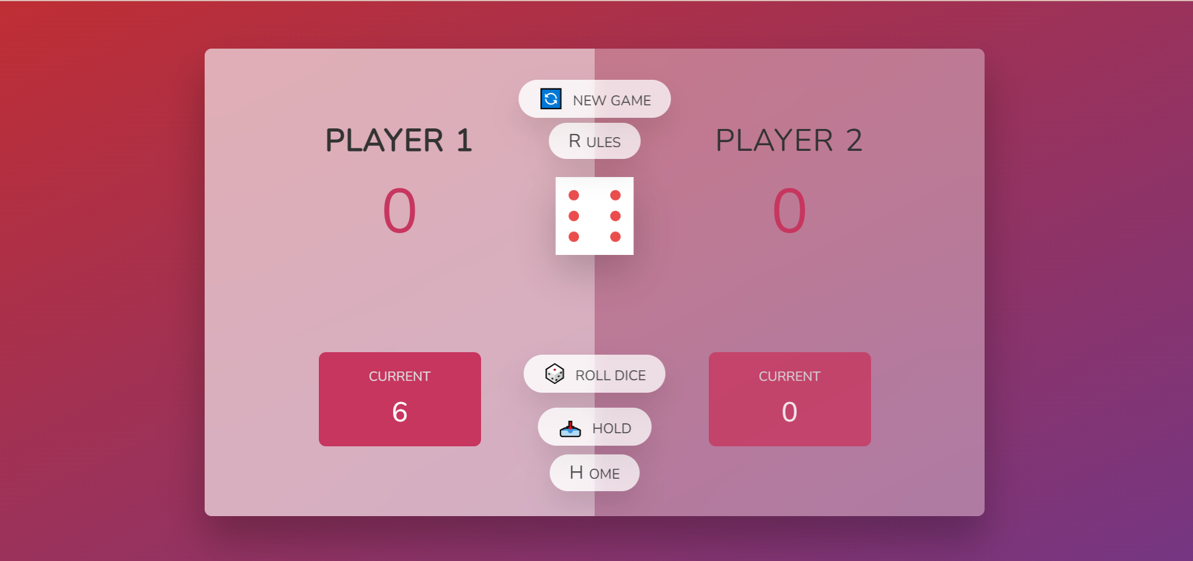
Image of Dice as per

Slide 20
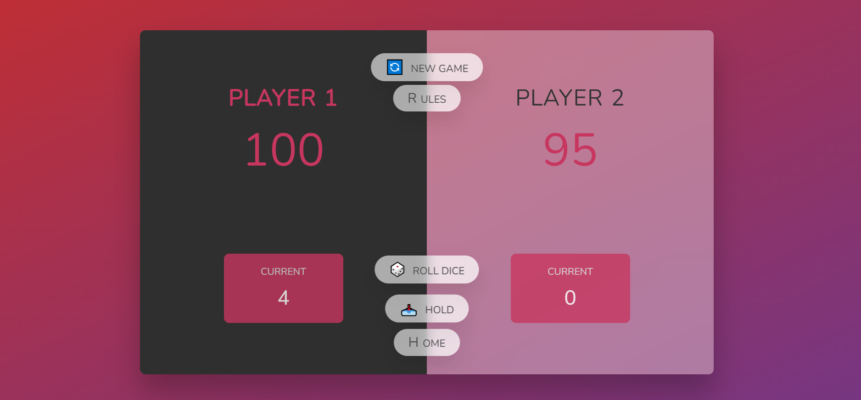
Winner-mode view of Roll The Dice Game

Slide 21
Language & Tools
Deploy strategic networks with compelling e-business needs
HTML
The main framework of Front-end Website
Python-Django
Disseminate standardized metrics
CSS
Styling of
SQLite
Foster holistically superior methodologies
JavaScript

Slide 22
Future Plan
Till now, my project has only two games and it runs on local host but when it will be global, I want to increase as more engagement as possible.
I will add more super interesting and fun game. I will also update the rules of the current game and will make it a little bit more complex.
I will name the website “Gamers Guild” where users can not only create account and log in but also they can see themselves progressing in leaderboard and have a competition within themselves. In this way, I hope I can reach out to many customers.

Slide 23
Summary
To sum up everything, “Multiple Games in One Web App” is a very user friendly and easy to handle app that can be run on both mobile and desktop browsers.
People with a little strategical knowledge irrespective of age and profession can play this game.
Primarily there are two games but as it’s a dynamic project so I may add more fun games later.
The ultimate motive of this project is to find a way to kill idle time and make break-hour more interesting.

Slide 24
Thank you
Raiyan Zannat
Undergraduate
BSc in CSE RUET
raiyan435jgcc@gmailcom

